Slide 1
A Poisson Analysis of Formula 1 Pit Stops
By Andrew Estes

Slide 2
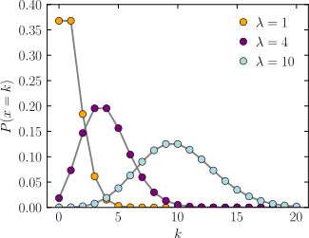
Poisson Distribution as defined by Wikipedia:
In probability theory and statistics, the Poisson distribution is a discrete probability distribution that expresses the probability of a given number of events occurring in a fixed interval of time or space if these events occur with a known constant mean rate and independently of the time since the last event.^{[1]} It is named after French mathematician Siméon Denis Poisson (/ˈpwɑːsɒn/; French pronunciation: ​[pwasɔ̃]). The Poisson distribution can also be used for the number of events in other specified interval types such as distance, area, or volume.
Notes:
https://en.wikipedia.org/wiki/Poisson_distribution

Slide 3
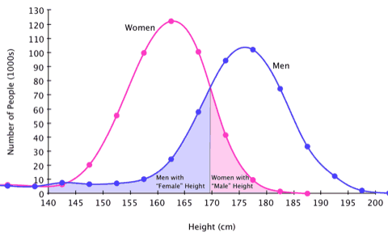
Notes:
https://sugarandslugs.wordpress.com/2011/02/13/sex-differences/

Slide 4
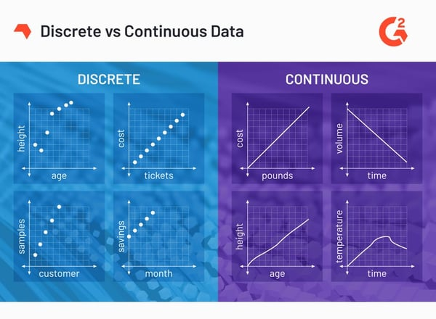
Notes:
https://datasciencedojo.com/blog/types-of-statistical-distributions-in-ml/

Slide 5
Discrete Distributions
Continuous Distributions
Discrete uniform distribution: All outcomes are equally likely
Bernoulli Distribution: Single-trial with two possible outcomes
Poisson Distribution: The probability that an event may or may not occur
Gaussian Distribution: Symmetric distribution of values around the mean
Student t-Test Distribution: Small sample size approximation of a normal distribution
Exponential distribution: Model elapsed time between two events
Notes:
https://datasciencedojo.com/blog/types-of-statistical-distributions-in-ml/

Slide 6
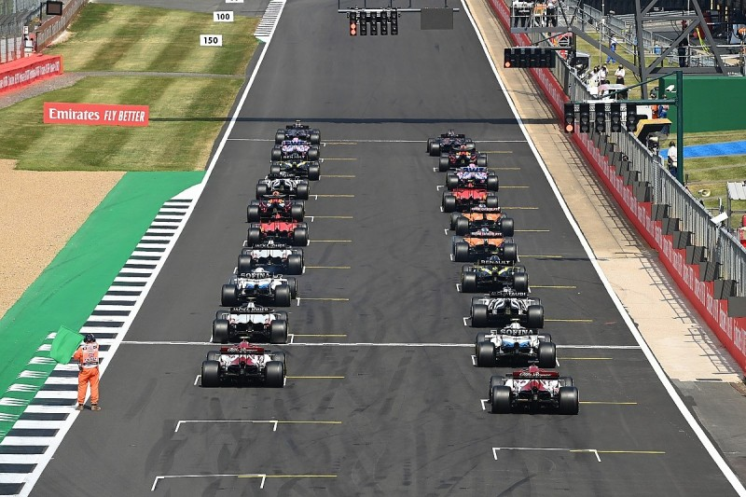
Notes:
Starting formation for the 20 cars, beginning of race

Slide 7
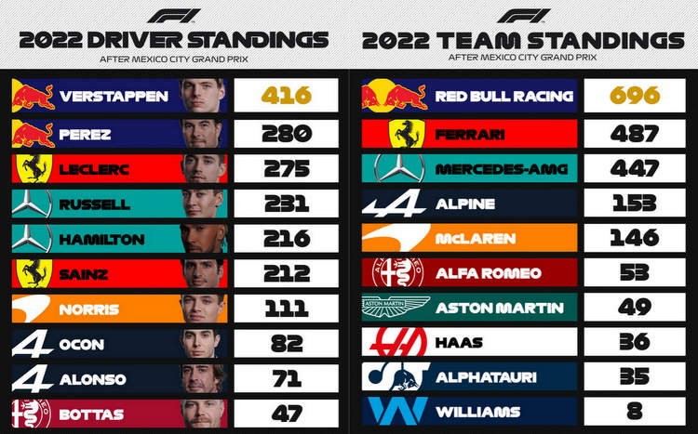

Slide 8
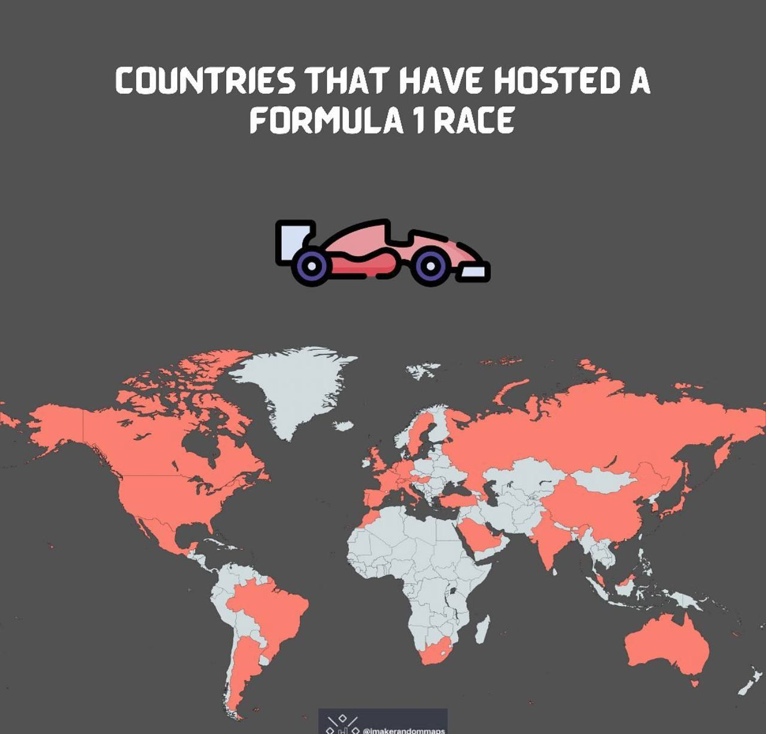

Slide 9
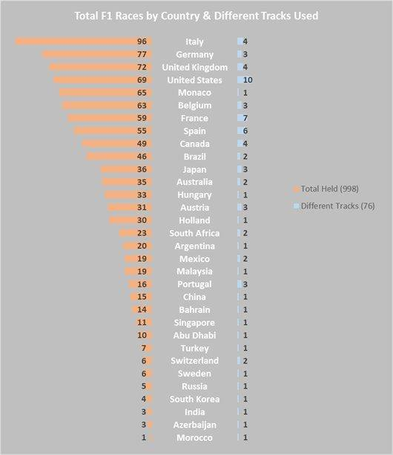

Slide 10
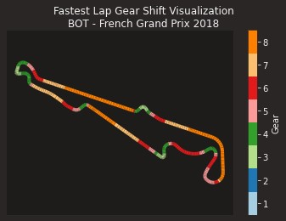
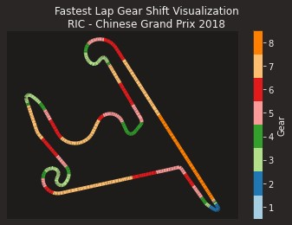
Notes:
Very different course layouts.
Also different geographic areas – North America, Central America, South America, Europe, Middle East, Far East, Australia.

Slide 11


Slide 12
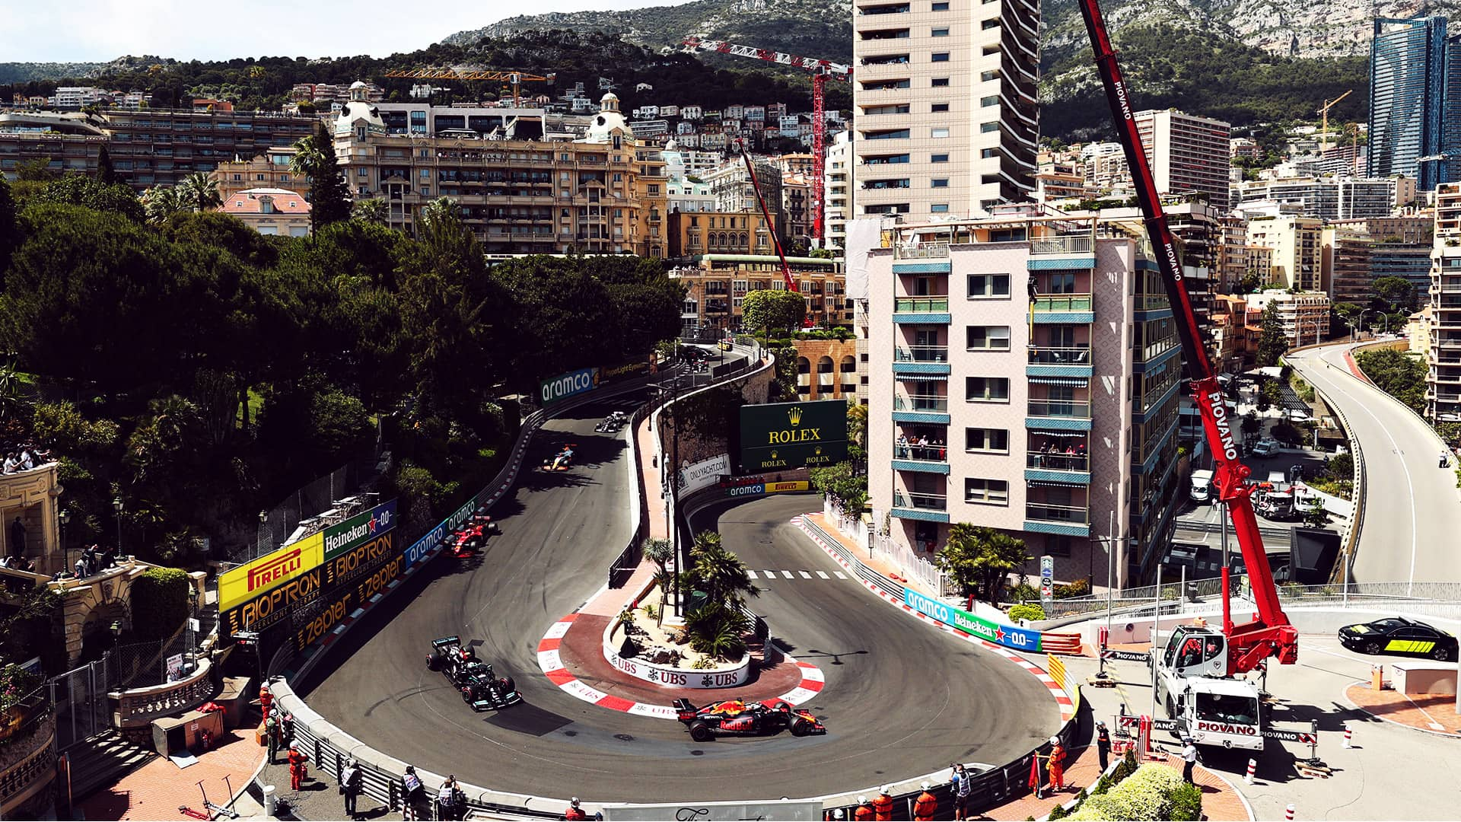
Notes:
In addition to course layout, difference in track vs street. Monaco, here, is on the streets that people use for normal traffic and can include these relatively severe changes in elevation and curves that are not normally found on a race-dedicated track.

Slide 13
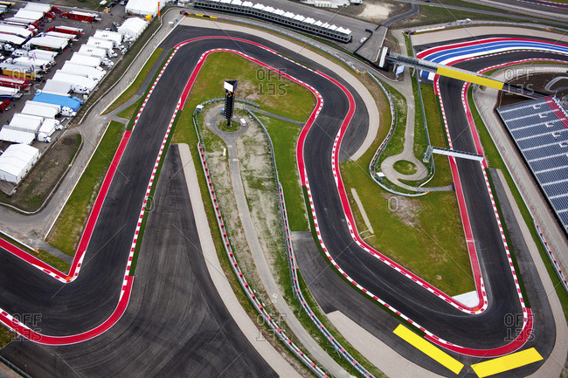

Slide 14
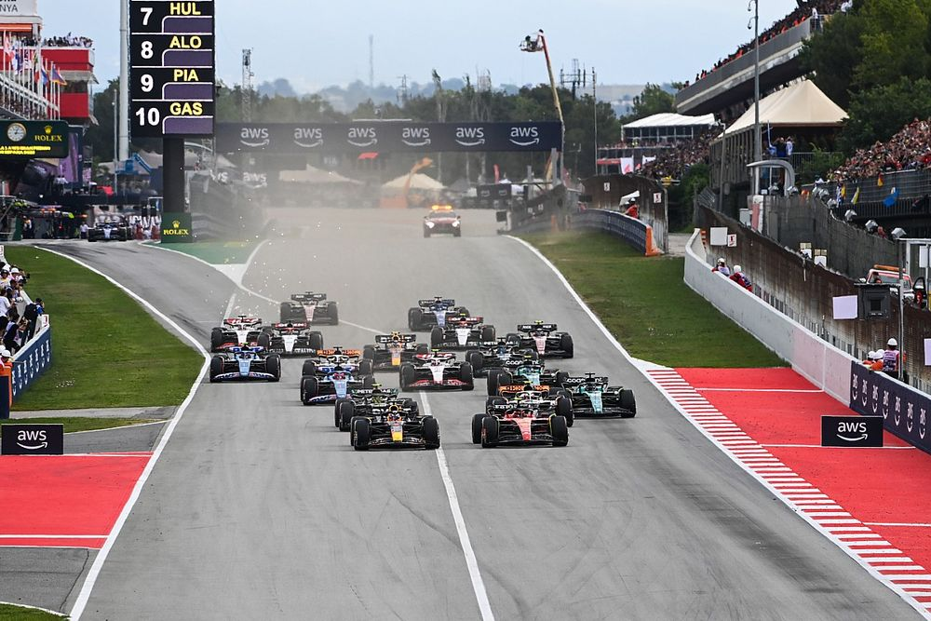
Notes:
A different view of the starting lap that shows the pit lane to the left side of the picture

Slide 15
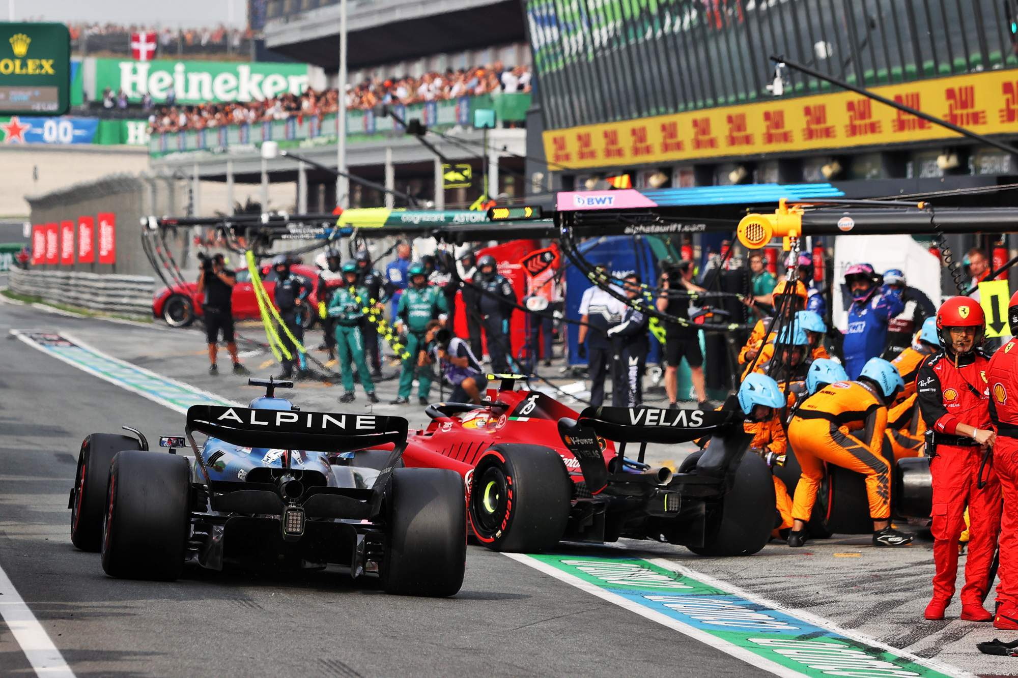

Slide 16
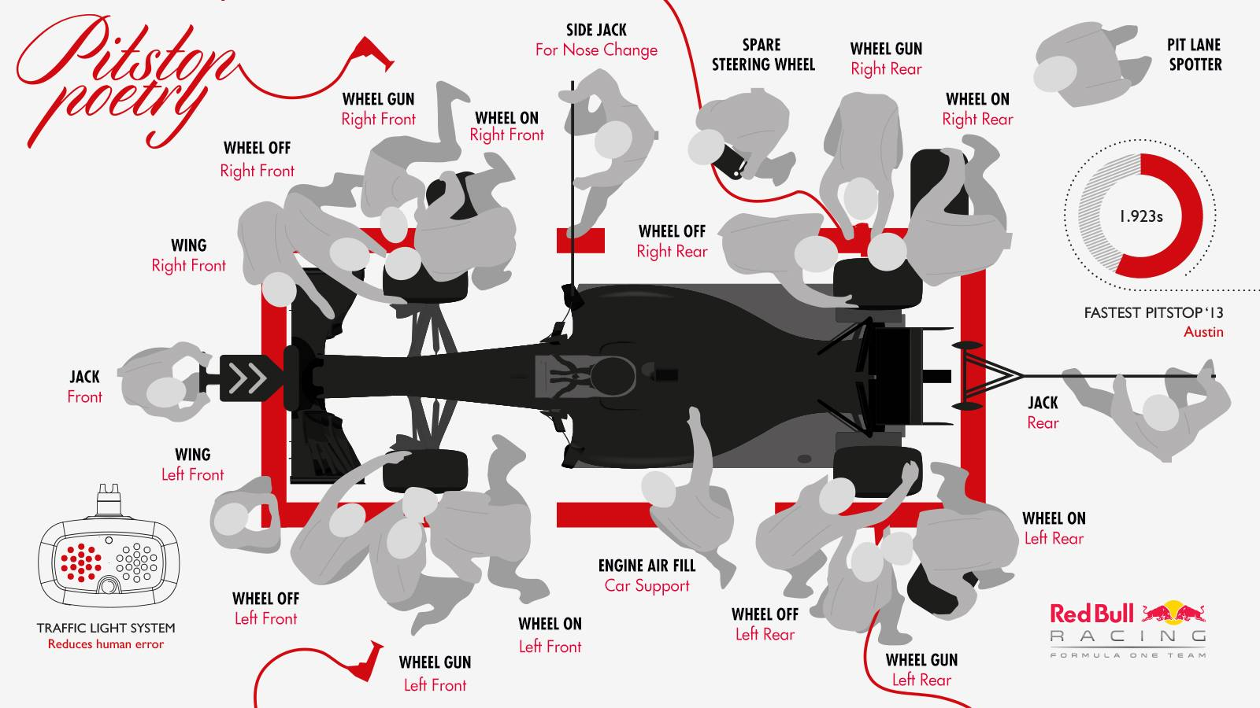

Slide 17


Slide 18
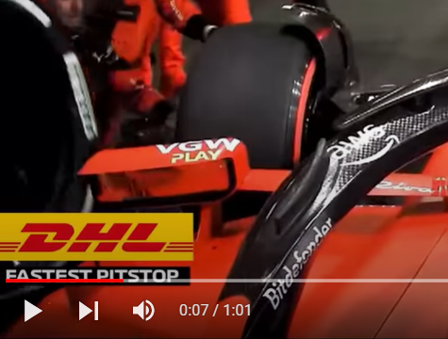
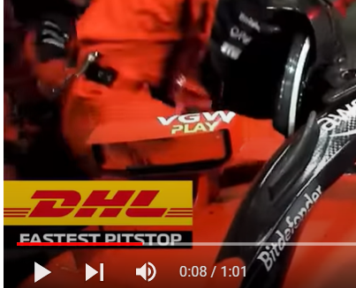

Slide 19

Notes:
https://www.formula1.com/en/latest/article.pirelli-confirm-tyre-choices-for-first-three-f1-races-of-2023-as-new.1xlpcTVaLqw0NeM3aYoyCt.html

Slide 20
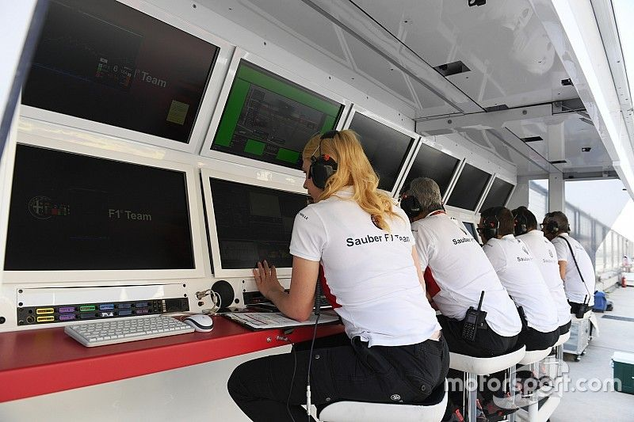

Slide 21
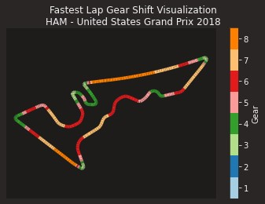
Notes:
Where is the startpoint?
Green in the top left, heading down

Slide 22
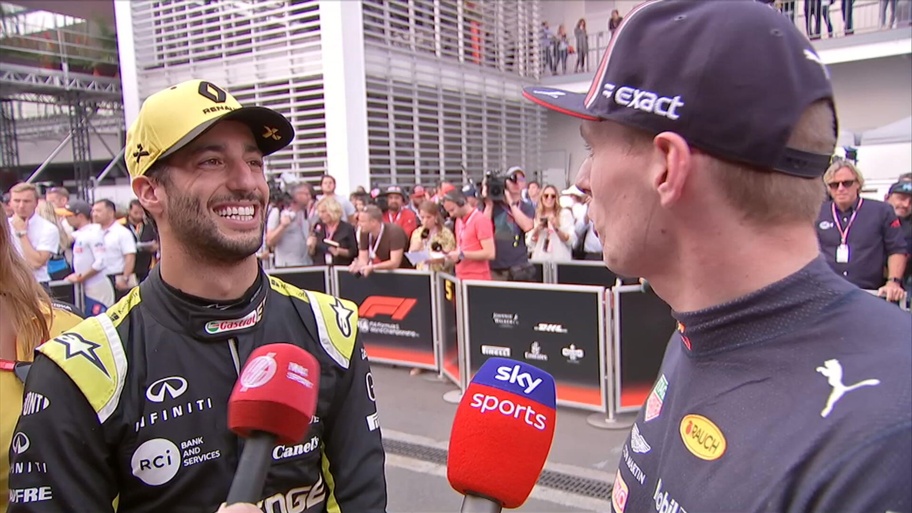
Notes:
I am now ready for questions

Slide 23
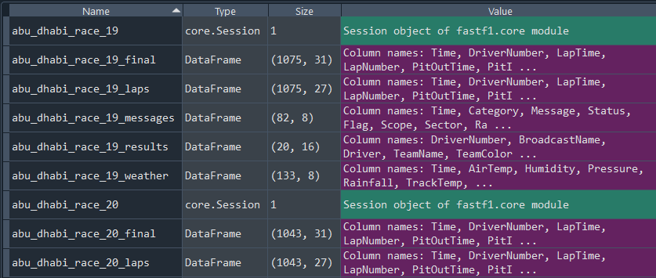

Slide 24
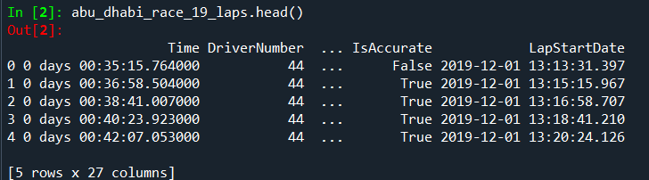
Dataframes: Laps

Slide 25
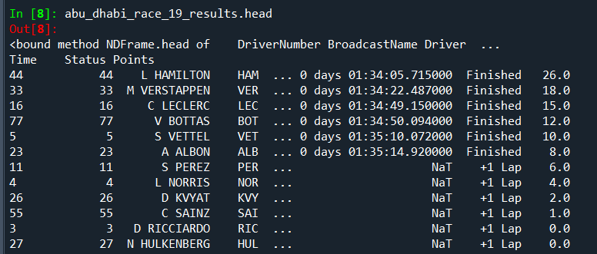
Dataframes: Results

Slide 26
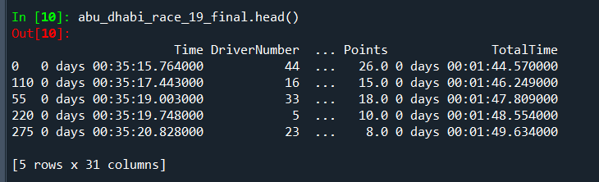
Dataframes: Final
abu_dhabi_race_19_final = pd.merge( abu_dhabi_race_19_laps,
abu_dhabi_race_19_results[[
'Driver', 'GridPosition', 'Position’, 'Points']],
on='Driver’,
how='left')

Slide 27
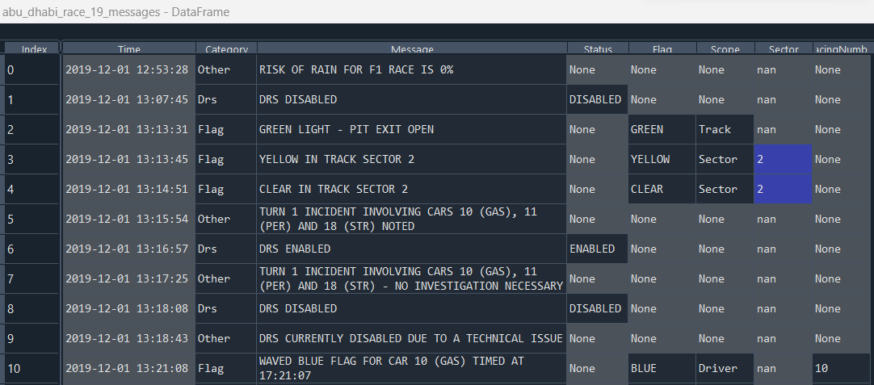
Dataframes: Messages

Slide 28
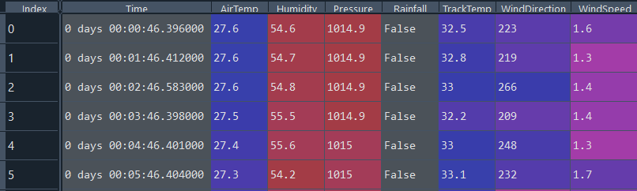
Dataframes: Weather

Slide 29
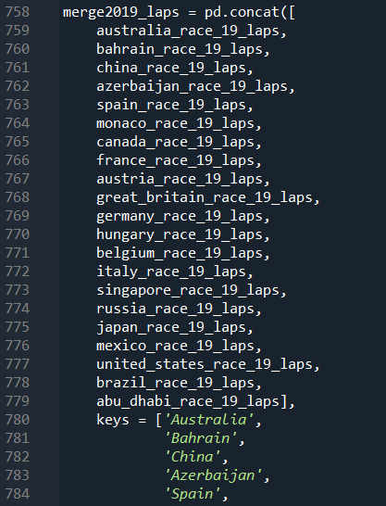
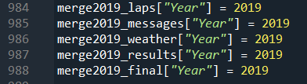
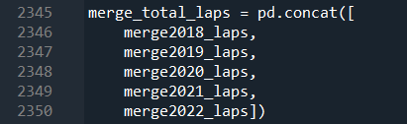
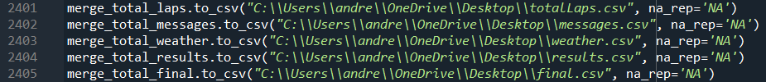
Data Transformations

Slide 30
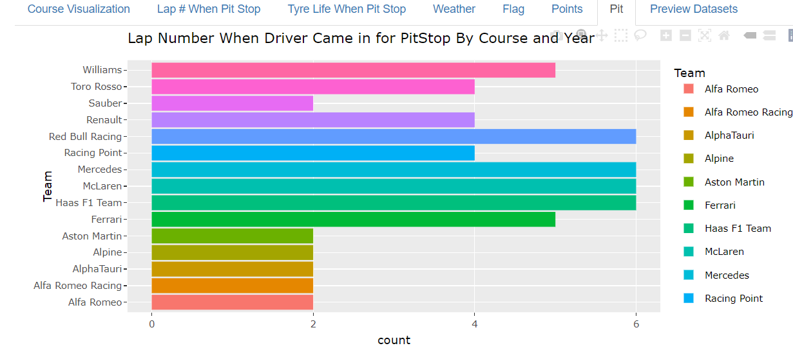
Shiny Visualization

Slide 31
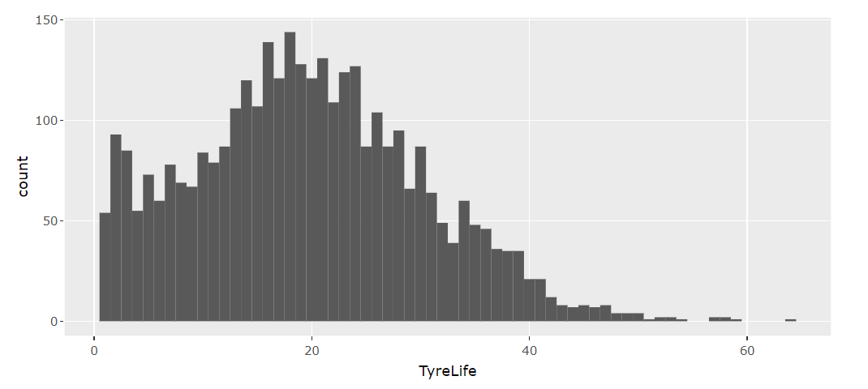
Tire Life When Pit Stop Made

Slide 32
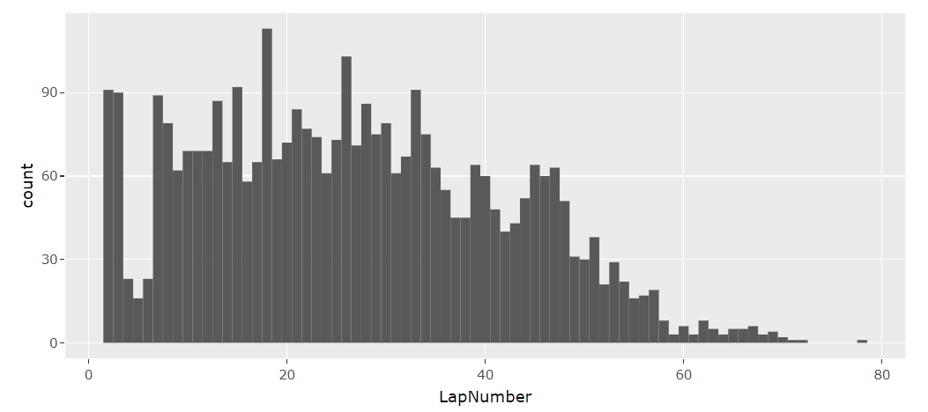
Lap Number When Pit Stop Made

Slide 33
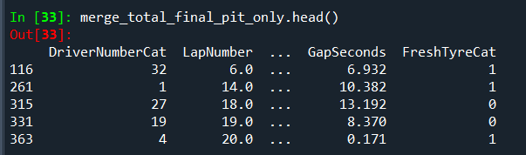
Reducing Dimensionality

Slide 34

Variance
Lap # When Pit Stop Made 46.567
Grouping by tire type 0.297
Mean
Lap # When Pit Stop Made 14.833
Grouping by tire type 0.479

Slide 35
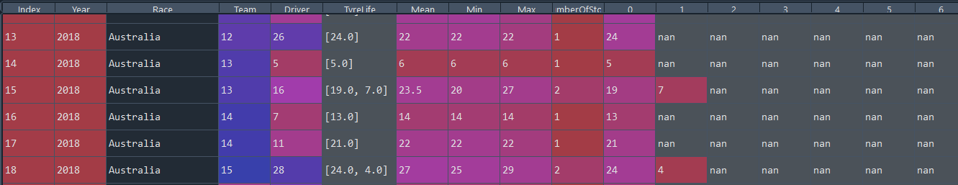
Pit Stop Data Frame

Slide 36
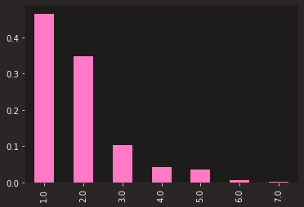
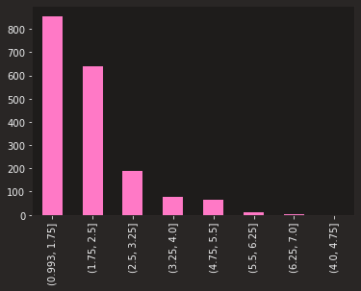
Normalized and Actual # of Pit Stops Per Race

Slide 37


Slide 38
Variable | Coef | Std Erro | Z | P | 0.025 | 0.975
TyreLife | 0.1357 | 0.002 | 61.849 | 0 | 0.131 | 0.14
Cumulative | 0.0006 | 8.62E-06 | 74.35 | 0 | 0.001 | 0.001
CumulativeLap | 0.001 | 1.31E-05 | 73.849 | 0 | 0.001 | 0.001
CumulativePit | 0.0015 | 2.16E-05 | 68.217 | 0 | 0.001 | 0.002
Sector1TimeSeconds | 0.0372 | 0.001 | 65.751 | 0 | 0.036 | 0.038
Sector2TimeSeconds | 0.05 | 0.001 | 68.866 | 0 | 0.049 | 0.051
Sector3TimeSeconds | 0.0371 | 0.001 | 67.139 | 0 | 0.036 | 0.038
PitTime | 0.0025 | 4.29E-05 | 58.611 | 0 | 0.002 | 0.003
PitOutTimeSeconds | 0 | 0 | nan | nan | 0 | 0
PitInTimeSeconds | 0.0004 | 5.19E-06 | 76.482 | 0 | 0 | 0
Stint | 1.0934 | 0.015 | 72.19 | 0 | 1.064 | 1.123
Gap | 0.0027 | 0 | 13.765 | 0 | 0.002 | 0.003
Fresh Tyre - FALSE | 2.8084 | 0.05 | 56.027 | 0 | 2.71 | 2.907
Fresh Tyre - True | 2.5713 | 0.056 | 45.564 | 0 | 2.461 | 2.682
TeamCat | 0.3661 | 0.007 | 54.139 | 0 | 0.353 | 0.379
DriverCat | 0.1939 | 0.003 | 60.429 | 0 | 0.188 | 0.2
DriverNumberCat | 0.1997 | 0.003 | 59.707 | 0 | 0.193 | 0.206
TrackStatusCat | 0.5792 | 0.01 | 55.519 | 0 | 0.559 | 0.6
Notes:
Poisson

Slide 39
Consul’s Poisson
Variable | coef | std err | z | P>|z| | [0.025 | 0.975]
Stint | 1.0922 | 0.031 | 35.145 | 0 | 1.031 | 1.153
Stint_alpha | 1.2417 | 0.216 | 5.747 | 0 | 0.818 | 1.665
TyreLife | 0.1365 | 0.005 | 25.987 | 0 | 0.126 | 0.147
TyreLife_alpha | 1.987 | 0.281 | 7.069 | 0 | 1.436 | 2.538
Sector1TimeSeconds | 0.0374 | 0.001 | 28.658 | 0 | 0.035 | 0.04
Sector1TimeSeconds_alpha | 1.6397 | 0.271 | 6.06 | 0 | 1.109 | 2.17
Sector2TimeSeconds | 0.0506 | 0.001 | 34.544 | 0 | 0.048 | 0.053
Sector2TimeSeconds_alpha | 1.123 | 0.21 | 5.339 | 0 | 0.711 | 1.535
Sector3TimeSeconds | 0.0374 | 0.001 | 30.331 | 0 | 0.035 | 0.04
Sector3TimeSeconds_alpha | 1.4451 | 0.255 | 5.665 | 0 | 0.945 | 1.945
DriverCat | 0.1984 | 0.008 | 25.492 | 0 | 0.183 | 0.214
DriverCat_alpha | 1.8954 | 0.291 | 6.504 | 0 | 1.324 | 2.467
DriverNumberCat | 0.2015 | 0.008 | 24.005 | 0 | 0.185 | 0.218
DriverNumberCat_alpha | 2.0324 | 0.312 | 6.513 | 0 | 1.421 | 2.644
TeamCat | 0.3762 | 0.017 | 21.984 | 0 | 0.343 | 0.41
TeamCat_alpha | 2.2141 | 0.334 | 6.636 | 0 | 1.56 | 2.868
FreshTyreFalse | 2.7766 | 0.073 | 38.12 | 0 | 2.634 | 2.919
FreshTyreTrue | 2.6103 | 0.079 | 33.005 | 0 | 2.455 | 2.765
FreshTyre_alpha | 0.4366 | 0.137 | 3.191 | 0.001 | 0.168 | 0.705
Notes:
Consul’s Poisson

Slide 40

Famoye’s Poisson
Notes:
Famoye’s Poisson

Slide 41
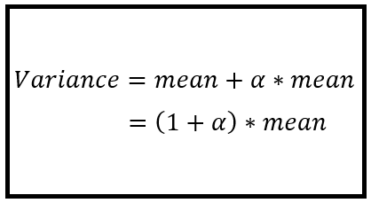
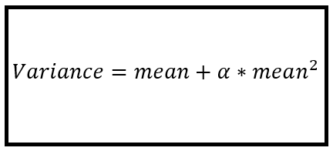
Negative Binomial: Which Model
Notes:
https://timeseriesreasoning.com/contents/negative-binomial-regression-model/
http://faculty.econ.ucdavis.edu/faculty/cameron/racd2/

Slide 42
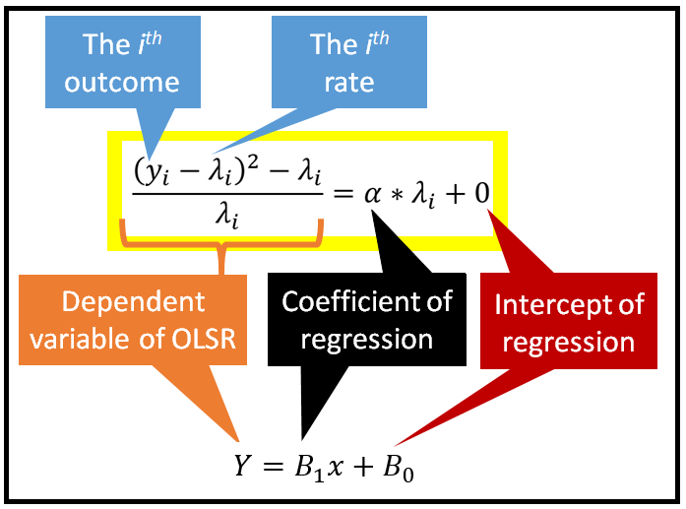
Negative Binomial 2
Notes:
https://timeseriesreasoning.com/contents/negative-binomial-regression-model/
http://faculty.econ.ucdavis.edu/faculty/cameron/racd2/

Slide 43
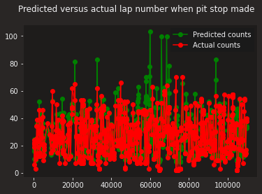

Slide 44
Variable | Importance
Sector1TimeSeconds' | 9.421%.
CumulativeLap' | 8.47%.
Sector2TimeSeconds' | 6.959%.
Sector3TimeSeconds' | 6.898%.
CumulativePit' | 5.435%.
TyreLife' | 4.298%.
EndPosition' | 2.19%.
TrackStatusCat' | 16.64%.
Cumulative' | 11.057%.
PitTime' | 10.172%.
PitInTimeSeconds' | 10.074%.
DriverCat' | 1.543%.
Gap' | 1.23%.
Points' | 1.067%.
Stint' | 1.043%.
StartPosition' | 0.891%.
TeamCat' | 0.881%.
DriverNumberCat' | 0.71%.
FreshTyreCat' | 0.592%.
CompoundCat' | 0.43%.
PitOutTimeSeconds' | 0.0%.
Random Forest
Notes:
Random Forest

Slide 45



Quasi-Poisson and Others
Notes:
https://cran.r-project.org/web/packages/pscl/vignettes/countreg.pdf
https://flexmix.nl/
https://stock.adobe.com/search?k=gee
https://www.google.com/imgres?imgurl=https%3A%2F%2Fwww.abbreviations.com%2Fimages%2F1686210_NLME.png&tbnid=xr2qAERW6FHBuM&vet=12ahUKEwjY39ilkub_AhXwhbAFHR3EA-EQMygBegUIARC_AQ..i&imgrefurl=https%3A%2F%2Fwww.abbreviations.com%2FNLME&docid=ma_2annBzs_ZyM&w=500&h=270&itg=1&q=nlme%20word&ved=2ahUKEwjY39ilkub_AhXwhbAFHR3EA-EQMygBegUIARC_AQ

Slide 46
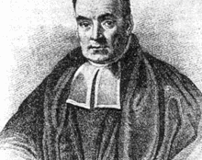
Bayesian Analysis
Simulate the Normal model
Posterior predictive check
Check predictive power
Simulate posterior predictive models
Plot the posterior predictive models
Summarize Cross Validated Model

